Slide 1
Object interaction
Creating cooperating objects
7.0

Slide 2
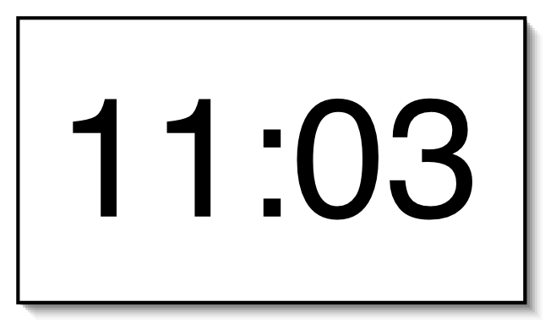
A digital clock

Slide 3
Abstraction and modularization
Abstraction is the ability to ignore details of parts to focus attention on a higher level of a problem.
Modularization is the process of dividing a whole into well-defined parts, which can be built and examined separately, and which interact in well-defined ways.

Slide 4



Modularizing the clock display
One four-digit display?
Or two two-digit displays?

Slide 5
Modeling a two-digit display
We call the class NumberDisplay.
Two integer fields:
The current value.
The limit for the value.
The current value is incremented until it reaches its limit.
It ‘rolls over’ to zero at this point.

Slide 6
Implementation - NumberDisplay
public class NumberDisplay
{
private int limit;
private int value;
public NumberDisplay(int limit)
{
this.limit = limit;
value = 0;
}
...
}

Slide 7
Source code: NumberDisplay
public String getDisplayValue()
{
if(value < 10) {
return "0" + value;
}
else {
return "" + value;
}
}

Slide 8
increment method
public void increment()
{
value = value + 1;
if(value == limit) { // Keep the value within the limit. value = 0; }
}

Slide 9
The modulo operator
The 'division' operator (/), when applied to int operands, returns the result of an integer division.
The 'modulo' operator (%) returns the remainder of an integer division.
E.g., generally: 17 / 5 gives result 3, remainder 2
In Java: 17 / 5 == 3 17 % 5 == 2

Slide 10
Quiz
What is the result of the expression 8 % 3
For integer n >= 0, what are all possible results of: n % 5
Can n be negative?

Slide 11
Alternative increment method
public void increment()
{
value = (value + 1) % limit;
}
Check that you understand how the rollover works in this version.

Slide 12
Implementation - ClockDisplay
public class ClockDisplay
{
private NumberDisplay hours;
private NumberDisplay minutes;
Constructor and
methods omitted.
}

Slide 13
Classes as types
Data can be classified under many different types; e.g. integer, boolean, floating-point.
In addition, every class is a unique data type; e.g. String, TicketMachine, NumberDisplay.
Data types, therefore, can be composites and not simply values.

Slide 14
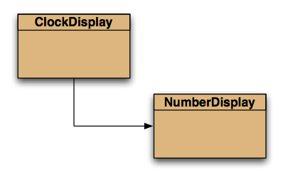
Class diagram

Slide 15
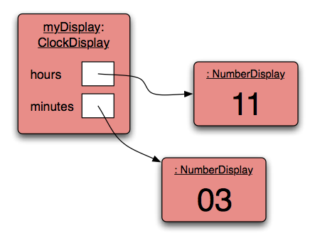
Object diagram

Slide 16
Objects creating objects
public class ClockDisplay
{
private NumberDisplay hours;
private NumberDisplay minutes;
private String displayString;
public ClockDisplay()
{
hours = new NumberDisplay(24);
minutes = new NumberDisplay(60);
…
}
}

Slide 17
Objects creating objects
in class ClockDisplay:
hours = new NumberDisplay(24);
argument
in class NumberDisplay:
public NumberDisplay(int rollOverLimit);
parameter

Slide 18
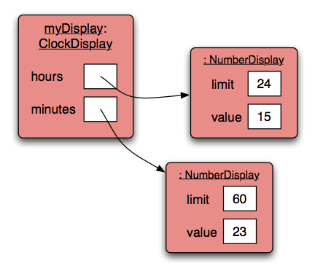
ClockDisplay object diagram

Slide 19
Quiz: What is the output?
int a; int b; a = 32; b = a; a = a + 1; System.out.println(b);

Slide 20
Quiz: What is the output?
Person a; Person b; a = new Person("Everett"); b = a; a.changeName("Delmar"); System.out.println(b.getName());

Slide 21
Primitive types vs. object types
SomeObject obj;
object type
int i;
primitive type
32

Slide 22
Primitive types vs. object types
ObjectType a;
ObjectType b;
b = a;
int a;
int b;
32
32

Slide 23
Key Concepts
abstraction
modularization
classes define types
class diagram
object diagram
object references
object types
primitive types

Slide 24
Object interaction
Two objects interact when one object calls a method on another.
The interaction is usually all in one direction (cf, ‘client’, ‘server’).
The client object can ask the server object to do something.
The client object can ask for data from the server object.

Slide 25
Object interaction
Two NumberDisplay objects store data on behalf of a ClockDisplay object.
The ClockDisplay is the ‘client’ object.
The NumberDisplay objects are the ‘server’ objects.
The client calls methods in the server objects.

Slide 26
Method calling
public void timeTick()
{
minutes.increment();
if(minutes.getValue() == 0) {
// it just rolled over!
hours.increment();
}
updateDisplay();
}
‘client’ method
‘server’ methods
internal/self method call

Slide 27
External method calls
General form: object . methodName ( arguments )
Examples: hours.setValue(theHour) minutes.getValue()
NB: object, not class name

Slide 28
Internal method calls
No variable name is required in the call:
updateDisplay();
Internal methods often have private visibility.
This prevent them from being called from outside their defining class (encapsulation).

Slide 29
Internal method
/**
* Update the internal string that
* represents the display.
*/
private void updateDisplay()
{
displayString =
hours.getDisplayValue() + ":" +
minutes.getDisplayValue();
}

Slide 30
Method calls
NB: A method call on another object of the same type would also be an external call.
‘Internal’ means ‘this object’.
‘External’ means ‘any other object’, regardless of its type.

Slide 31
Static methods
Instance methods are also known as 'non-static methods'.
An instance method is called on an individual object (instance of its class).
A static method belongs to its class rather than an object.
A static method is called on its class.

Slide 32
Static methods
A static method has the keyword static in its header. E.g., the abs method in the Math class: public static int abs(int a)
A static method is called via its class name: int positiveValue = Math.abs(x);

Slide 33
Static methods
The static format method in the String class is useful for formatting text; e.g.
public String getStudentDetails() { return String.format(
"name: %s, ID: %s, credits: %d", name, id, credits); }

Slide 34
The debugger
Useful for gaining insights into program behavior …
… whether or not there is a program error.
Set breakpoints.
Examine variables.
Step through code.

Slide 35
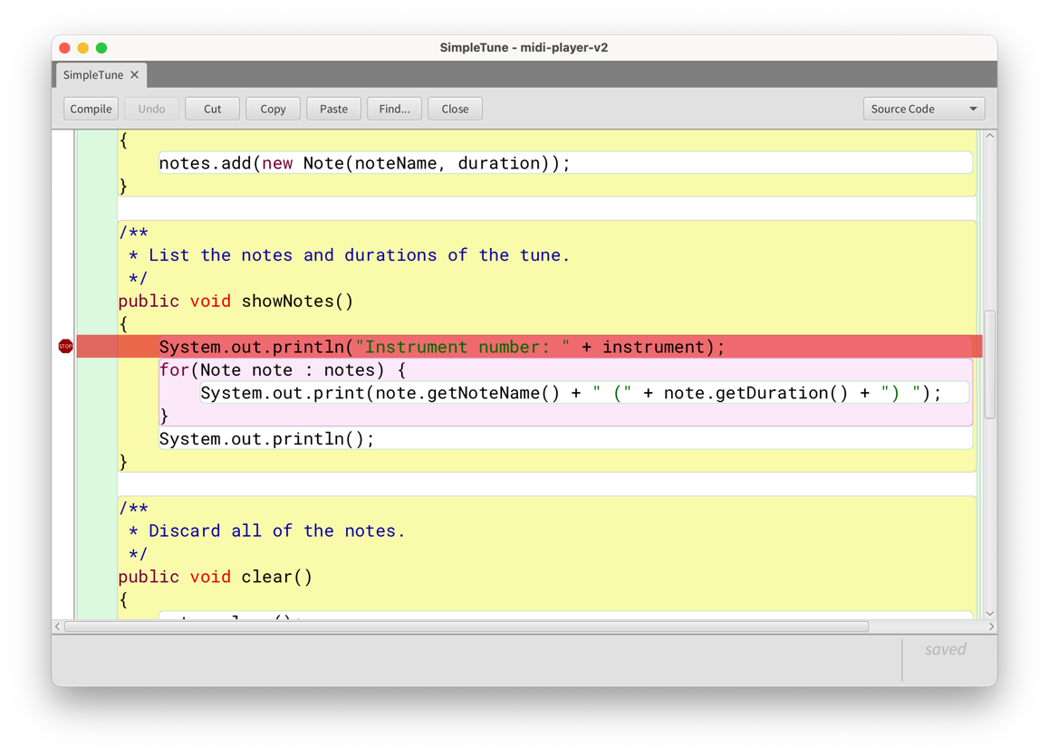
The debugger

Slide 36
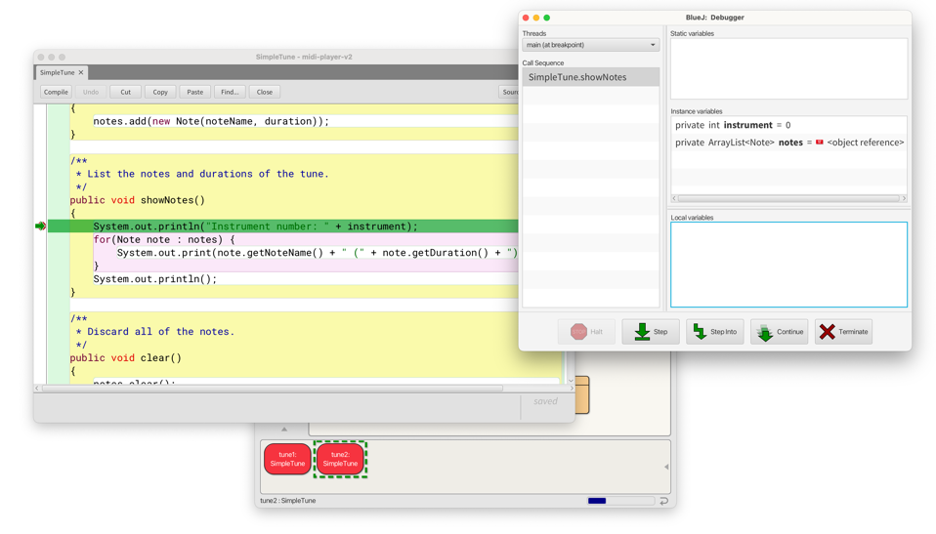
The debugger

Slide 37
Concept summary
abstraction
composition
object creation
internal/external method calls
static methods
the debugger

